Slide 1

EXPLORING AI AND ROBOTIC INNOVATIONS FOR IMPROVED OPERATIONS
- PRAVALLIKA
ENHANCING CONVERSATIONAL AI IN CHENNAI CAFÉ

Slide 2
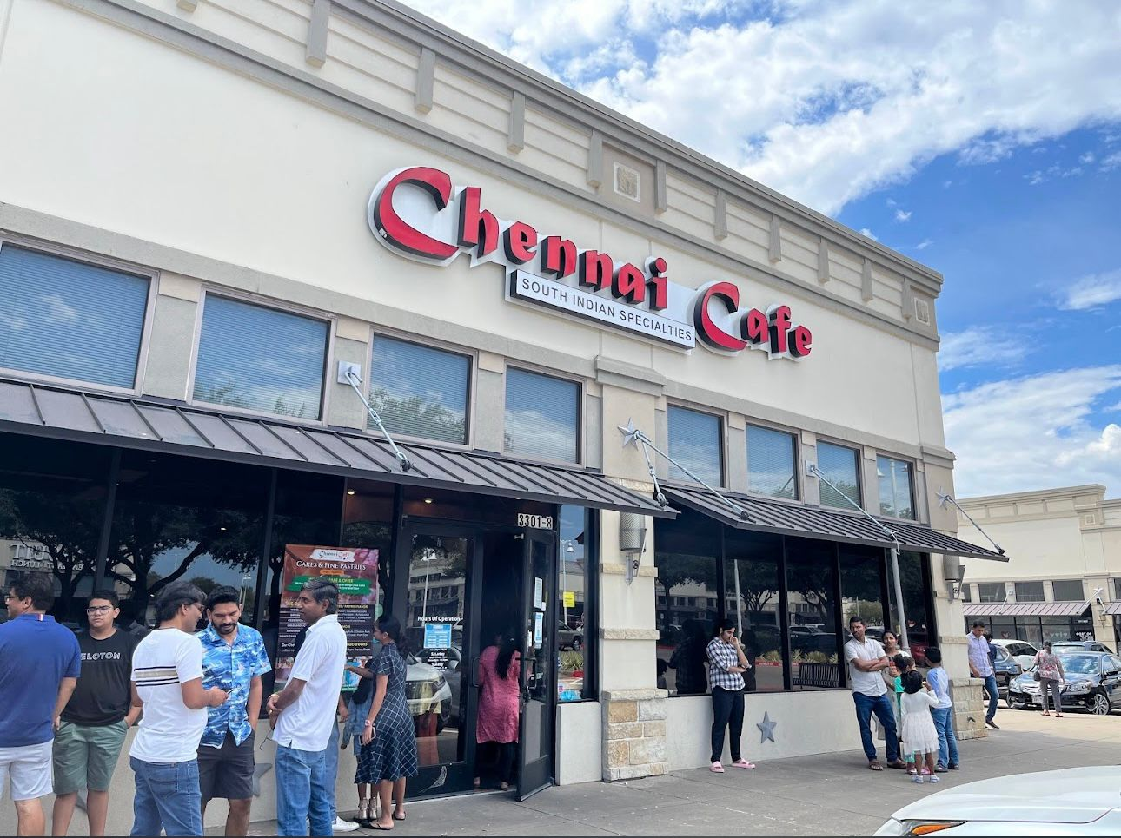
INTRODUCTION
Chennai cafe is a south Indian restaurant established in 2011.
The first Indian restaurant in Dallas to utilize robots for service.
It offers a fusion buffet Showcasing south Indian culinary traditions.

Slide 3

PURPOSE OF AI AND ROBOTIC INTEGRATION
Upgradeable to manage reservations, collect payments, and offer personalized recommendations.
Upgradeable to manage reservations, collect payments, and offer personalized recommendations.
Enhance Robot Functionality :
Current use is only limited to trash collection .
Potential to expand usage to order taking, food delivery, and customer interaction.
Improve Conversational AI :
Currently answers only basic questions.
It can be upgradable to manage reservations , collect payments and offer personalized resommendations.

Slide 4
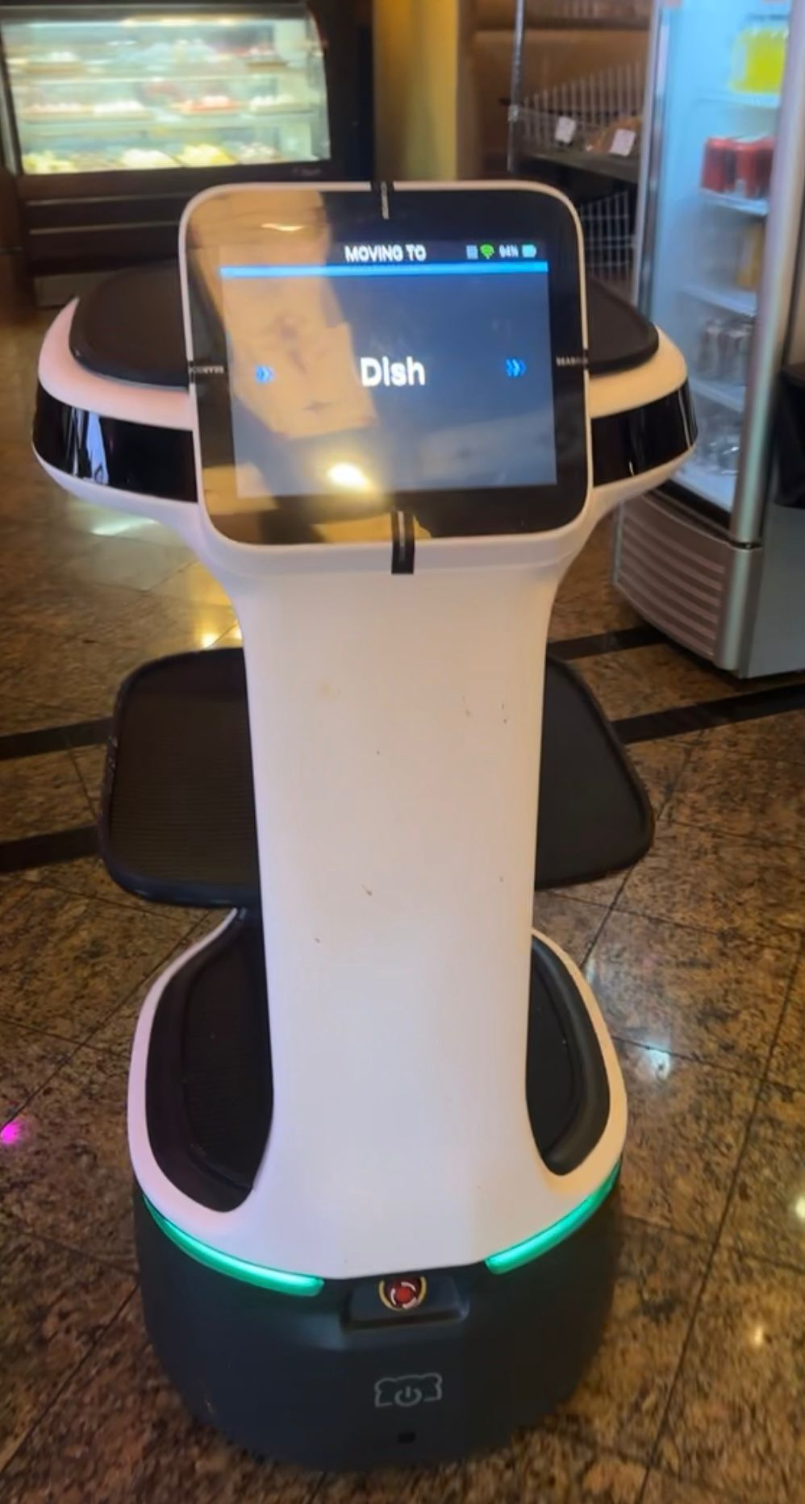
CURRENT TECHNOLOGIES
Enhance Robot Functionality:
Current use is limited to trash collection.
Potential to expand usage to order taking, food delivery, and customer interaction.
Improve Conversational AI:
Currently answers only basic, unhelpful questions.
Can be upgraded to handle personalized recommendations, payment processing, and reservation management.

Slide 5
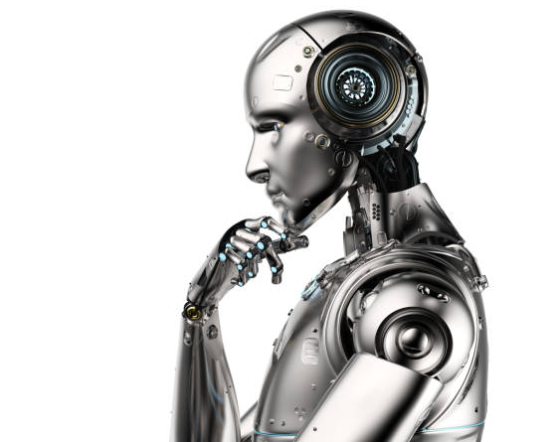
OPPUTUNITIES FOR ENHANCEMENT
Extending Robotic Capabilities and Recommendations for new functions that robots could perform, such as food delivery, customer service, and order taking.
Advantages of increasing robot capabilities for improved customer service and increased operational effectiveness.
Personalized recommendations, reservation management, and customer inquiry handling are some suggestions for enhancing conversational AI.

Slide 6

IMPLEMENTATION AND CONSIDERATIONS
Software compatibility issues, hardware constraints, and integration difficulties are some of the obstacles that robots and AI systems may encounter as they evolve.
The key to guaranteeing operational efficiency is the smooth integration of new technology into current workflows and the effective training of staff members.
Technology, training, and infrastructure changes come at an initial expense when implementing robotic and AI advancements.

Slide 7

CONCLUSION
To conclude, there are many ways we can use Conversational AI in this restaurant, including enhancing customer service with various Options.
In addition to trash collection, we can use this AI for promotional purposes, payments, food delivery, and to position the restaurant as a leading AI-driven Indian restaurant.

